Slide 1

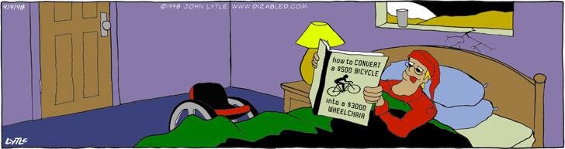
Power of Persons with Disabilities, Advocacy and the Challenges
50 wheelchair users pull Boeing: http://www.youtube.com/watch?v=9R3zE13rRhQ
Wheelchair Design for Developing Countries, MIT, Instructors Amos Winter and Amy Smith: http://web.mit.edu/sp.784/www/ Presented by Maryan Amaral, March 3, 2009

Slide 2

Disability Advocacy
• Introduction:
• ADA: Civil Rights, disability discrimination
• Medical diagnosis and functional abilities
• Different type of wheelchairs
• Wheelchair Recyclers
• Aero, Inc., wheelchair integrated dance

Slide 3


More of Leeder Dizabled Cartoons: http://www.dizabled.com
See wheelchair user perform wheelchair backflip! Visit:
http://video.google.com/videoplay?docid=656193898147576910

Slide 4
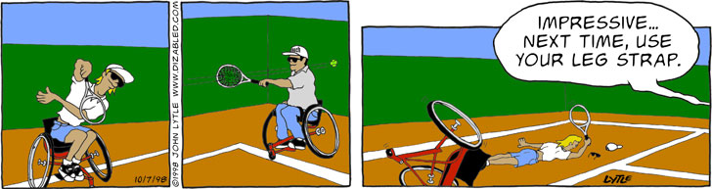
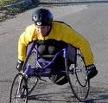



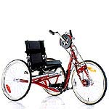
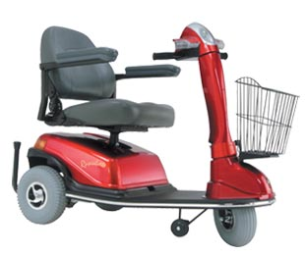

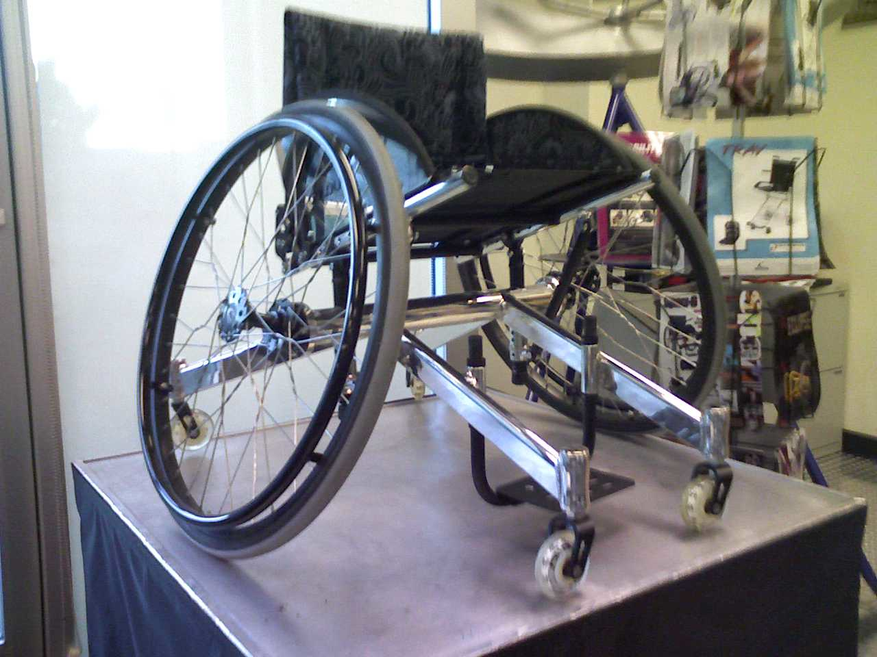
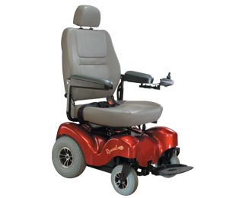


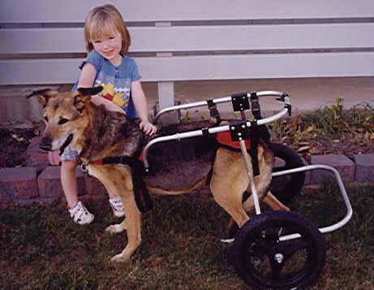
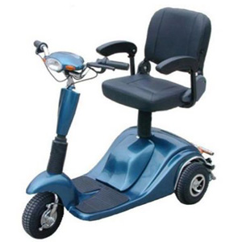


Diff
Different Types of Wheelchairs
Bikes, trikes,
Handcycles, others
Manual Wheelchairs
Powerchairs
Electric Scooters
Racing wheelchair
Handcycle
Wheelchair tennis
An everyday general use wheelchair
Wheelchair rugby
Colours tennis
Trike in developing countries
Pet wheelchairs
Hospital chair
Two and three wheel electric scooters

Slide 5





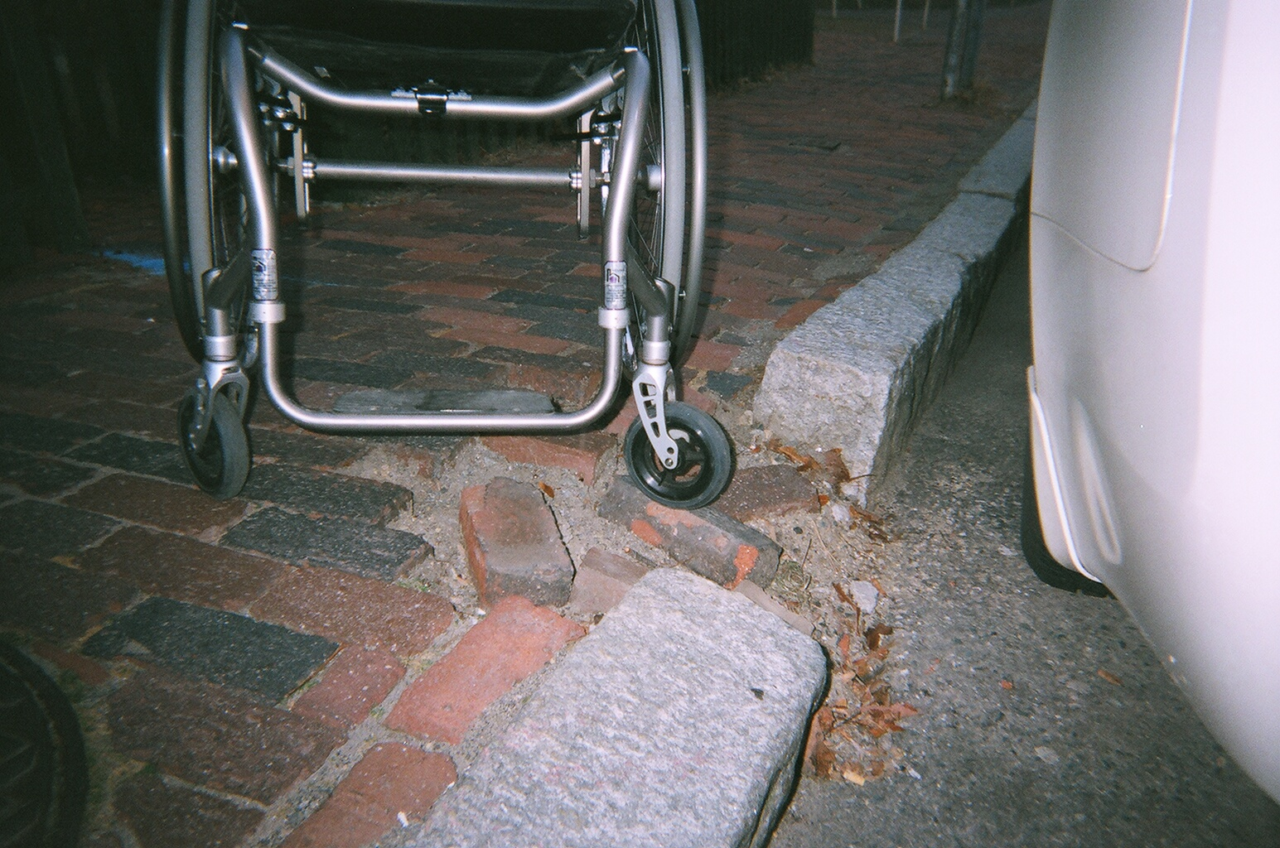
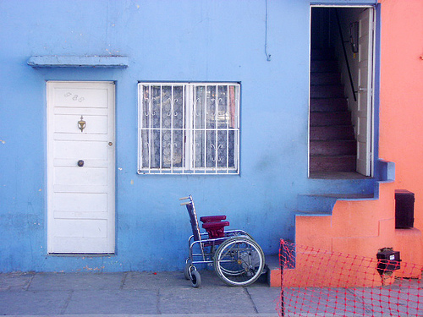



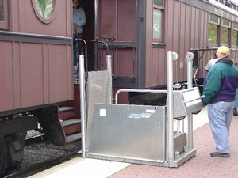
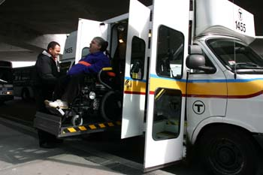

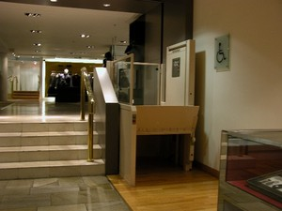
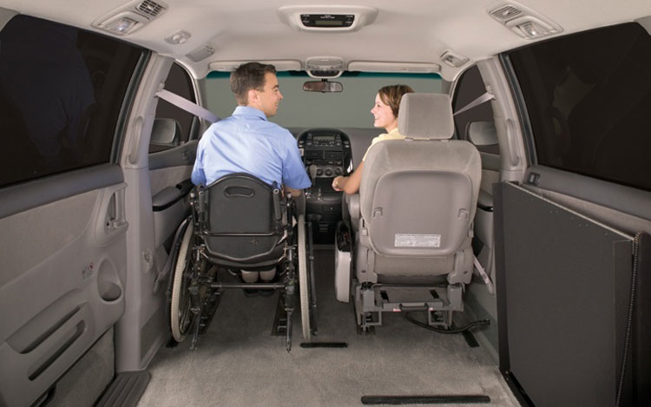
Can you spot the physical access barriers?
Wheelchair Etiquette
• “ Disability” (not handicapped)
• Focus on “person”, (not disability)
• “ Wheelchair user, rider, driver”
“if you take my disability parking spot, you can take my disability”
Solutions?
Hand cranked wheelchair lift at MBTA
MBTA the RIDE
Attractive wheelchair ramp
Wheelchair lifts
Adapted van

Slide 6


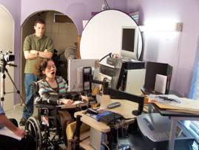

Civil Rights legislation and access building code USA Regulations to Protect People with Disabilities
1990 Americans with Disabilities Act ADA
Title I: Employment
Title II: Public entities
Title III: Public accommodations and businesses
http://www.ada.gov/
Massachusetts Architectural Access Board- Public Safety Dept.
AAB
One Ashburton Place
Boston, MA 02120
617-727-0660

Slide 7


Human Functional Limitations/Abilities
Hand strength and coordination, spasticity
Arms, stretch, coordination, range of movement
Leg strength and coordination, paralysis
Amputations of arms or legs
Trunk control, ataxia
Sensation of arms, seat, and limbs
Vision, hearing, ability to communicate
Traumatic Brain Injury, judgement
Acquiring a new physical disability can feel like you are in different planet

Slide 8
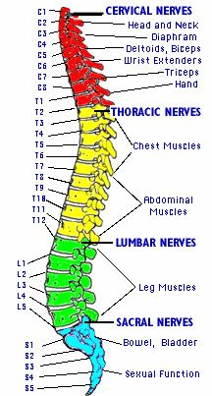


Physical Dis-Abilities
Spinal Cord Injury
Quadraplegia/ Tetraplegia
(complete or incomplete lesion)
Involves arms, trunk and legs
Paraplegia, trunk and legs
http://www.spinalcord.uab.edu/
-------------------------------------------------
Cervical level of injury: C1 to C8.
Thoracic- T1 to T12
Lumbar- L1 to L4-5
Christopher Reeve sustained a high level spinal cord injury (C4) incomplete. He had paralysis of his arms, trunk, legs and used a vent to breathe.
Maureen McKinnon, 2008 Paralympic Gold Medalist Sailing, paraplegic
Christopher Reeve Foundation
http://www.christopherreeve.
org/m
http://www.sailing.org/25021.php
Picture of the human spinal cord and areas of body affected if injured. Body paralysed below level of injury. Incomplete means not a full lesion to the cord. Complete injury means complete lesion to the cord.

Slide 9






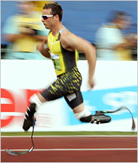

Physical Dis-Abilities
Cerebral Palsy
Polio
Birth injury to brain. Loss use of arms and legs, may walk with limited aid or fully involved. http://www.ucp.org/ucp_generaldoc.cfm/1/9/37/37-37/447
Disease caused by virus affects lungs and causes paralysis. Usually able to walk or travel with assisted mobility device
http://www.lastchild.org/polio-facts.html
M.S.
Stroke
Demylinating disease is progressive affecting young adults- People able to walk, decline to more paralysis.
http://www.themcfox.com/multiple-sclerosis/ms-facts/multiple-sclerosis-facts.htm
Hemiparesis, or hemiparalysis (one sided)
speech, ataxia, vision loss,
Cognitive loss. Use walker, cane, power-wheelchair
http://www.st-johns.org/services/stroke_center/stroke_facts.aspx
Lou Gehrig’s Disease
Muscle Wasting, speech loss-
Professor Hawking
http://www.alsa.org/als/facts.cfm
ALS
Amputations
Use prosthetics,
Wheelchairs, skateboards
http://www.amputee-coalition.org/absolutenm/anmviewer.asp?a=314
Traumatic Brain Injury
Injury to the brain
http://www.cdc.gov/ncipc/factsheets/tbi.htm

Slide 10
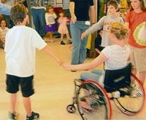
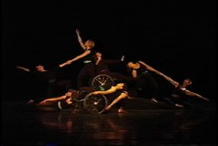

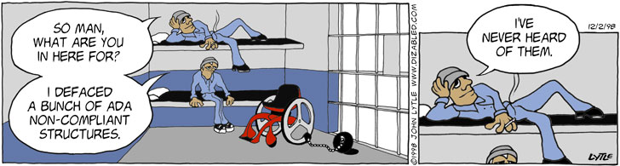


AERO, Inc. and Citizens for Access, Inc. and Wheelchair Recycler, Inc.
Maryan Amaral, Artistic Director
Aero, Inc., an integrated mixed abilities dance company
http://
Wheelchair Recycler, Inc.
http://www.aeroinc.org,
http://citizensforaccess.blogspot.com
http://wheelchairrecycler.org/
Thanks Amos Winter and Amy Smith for inviting me present today in Wheelchair Design for Developing Countries lecture.
Thanks to members of our class for your great input ☺ Maryan

